Slide 1

A case study from Indian e-commerce customers
Chaganti Sai Mahathi

Slide 2
Agenda:
1. Customer Retention- Problem Analysis
2. Steps to Process EDA
3.Step1:Data Analysis
4.Step2:Data Visualization
5.Encoding
6.Step3: Correlation
7.Feature selection process
8.Conclusion

Slide 3
Customer Retention- Problem Analysis
1
Customer retention is one of the most important factor for a successful eCommerce business .
Customer retention defines as the ability of a business to avoid customer defection for a while, and It also includes all activities that a business engages in to ensure customer loyalty and retaining your existing customers is one of the best ways to increase your recurring revenue and average cart value.
Five major factors that contributed to the success of an e-commerce store have been identified as: service quality, system quality, information quality, trust and net benefit.
The Data collected is from the Indian online shoppers. Results indicate the e-retail success factors, which are very much critical for customer satisfaction.
The given model is a classification model which is used to predict the best Indian online retailer would you recommend to a friend based on the various feedback details and reviews of the daily online customers
2
3
4
5

Slide 4
Steps to Process EDA:
1
Import all the necessary Libraries.
Load the dataset.
2
Checking the null values and null count of each column in the given dataset- No Null count.
Data Visualization using bar graph.
3
Encoding the data.
Checking Outliers and Skewness.
getting the data dimension - (269, 71)
Data type of each column of the data frame is given below.
Getting the value counts of each column of the data frame.
Describing the dataset.
Checking the correlation.
Feature Selection Process.
Creating a Desired model.

Slide 5
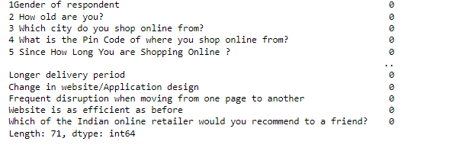
Step1:
Null values and Null count of each column in the given dataset
1)There are 269 rows, and 71 columns present in the data set.
2) The given model is a classification model which is used to predict the best Indian online retailer would you recommend to a friend based on the various feedback details and reviews of the daily online customers.
3)Data type is Object type.
4)There is no null count present in the dataset.

Slide 6
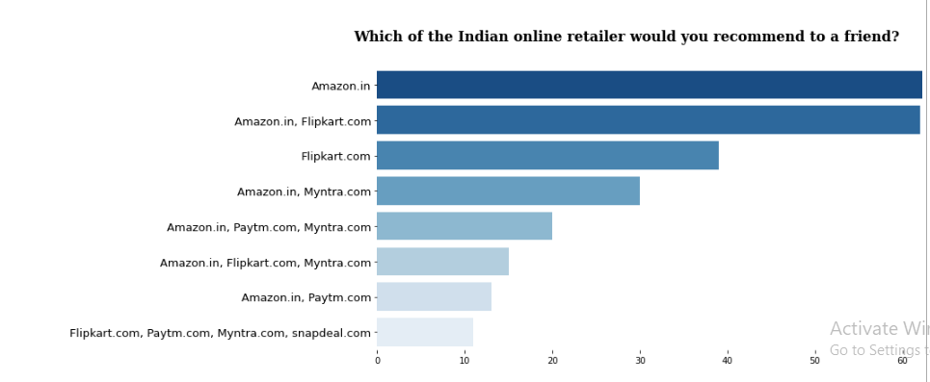
Amongst all the retailing online websites Amazon is the highest retailer that any customer would recommend based on the Data Collected from the Indian Online shoppers using all the feature details.
Step 2:
Data Visualization using bar graph:

Slide 7
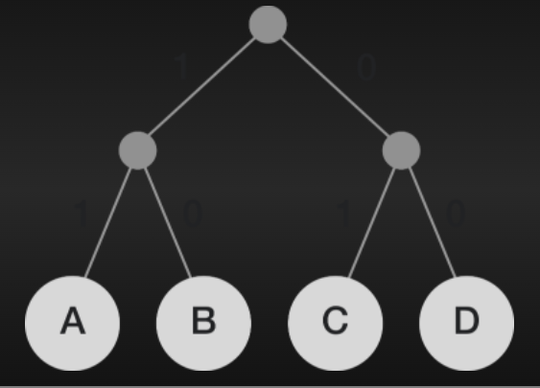
Encoding of Data
Label Encoder:
Encoding the target variable using label encoder.
Ordinal Encoder:
Encoding all the other features using Ordinal encoder since the features are in object type.

Slide 8
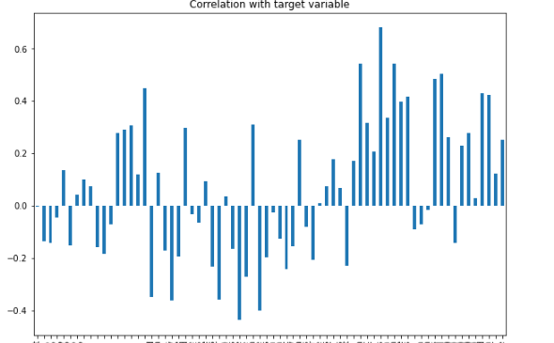
Step3
Correlation
Correlation of the target variable with respect to all the other features.
Code Used:
df.drop('Which of the Indian online retailer would you recommend to a friend?',axis=1).corrwith(df['Which of the Indian online retailer would you recommend to a friend?']).plot(kind='bar',grid=False,figsize=(10,7),title='Correlation with target variable')
plt.show()

Slide 9
Outliers and skewness of the data need to be identified, since there is no much clear output we are going to choose the top 50 best features of the data using Feature Selection Process
Some of the features that got selected:
Code:
best_features=SelectKBest(score_func=f_classif,k=50)
fit=best_features.fit(x,y)
'9 What is the screen size of your mobile device?\t\t\t\t\t\t ',
'Visual appealing web-page layout',
'23 Loading and processing speed',
'Longer time in displaying graphics and photos (promotion, sales period)',
'Limited mode of payment on most products (promotion, sales period)',
'Wild variety of product on offer',
'13 After first visit, how do you reach the online retail store?\t\t\t\t ',
'Presence of online assistance through multi-channel',
'17 Why did you abandon the “Bag”, “Shopping Cart”?\t\t\t\t\t ‘,………and so on
New Data Frame is created using these features and target variable and the desired model gets created using this modified dataset.

Slide 10
Conclusion
Customer retention is Primary aspect that the Online shopping needs to take care of .
Here this model consists of 71 columns after the analysis of data we come to the conclusion that the given data can be classified using Random Forest classifier, KNN model. And so on to get the prediction of the top rated efficient website. Here, this gives an information regarding the data before modelling the data we need to analyse and pre-process the data like checking the null count, visualising the data and checking the outliers and skewness if exists any dropping the unwanted columns and also feature selection methods are used to get the require data for model processing

Slide 11


